Slide 2
Trees
A lot of concepts and definitions follows from Section 5 : Introduction to Graph Theory
Syllabus
Properties of Trees
Rooted Trees and Binary Trees
Binary Search Trees

Slide 3
Trees : Properties of Trees
1) Characteristics of a Tree
A tree is a connected graph that contains no cycles. A tree has no loops and no
multiple edges. All trees are simple graphs.
2) Path Graphs
A tree that contains only vertices of degree one or two is called a path graph.
The length of a path graph is the number of edges in it.
3) Number of Edges
(Theorem) Let T be a tree with n vertices. Then T has n − 1 edges.
Therefore, the sum of the degree sequence is necessarily 2n-2

Slide 4
Trees : Properties of Trees
4) Spanning Subgraphs
The graph H is a subgraph of a graph G if H’s vertices are a subset of the G’s
vertex, its edges are a subset of the edge set of G, and each edge of H has the
same end-vertices in G and H.
H is called a spanning subgraph of G if the vertices of H are the same as the
vertices of G.
5) Spanning Trees
If H is a spanning subgraph which is also a tree, then H is said to be a spanning
tree of G. (G does not need to be a tree)

Slide 5
Trees : Properties of Trees
Spanning Trees (Figure)

Slide 6
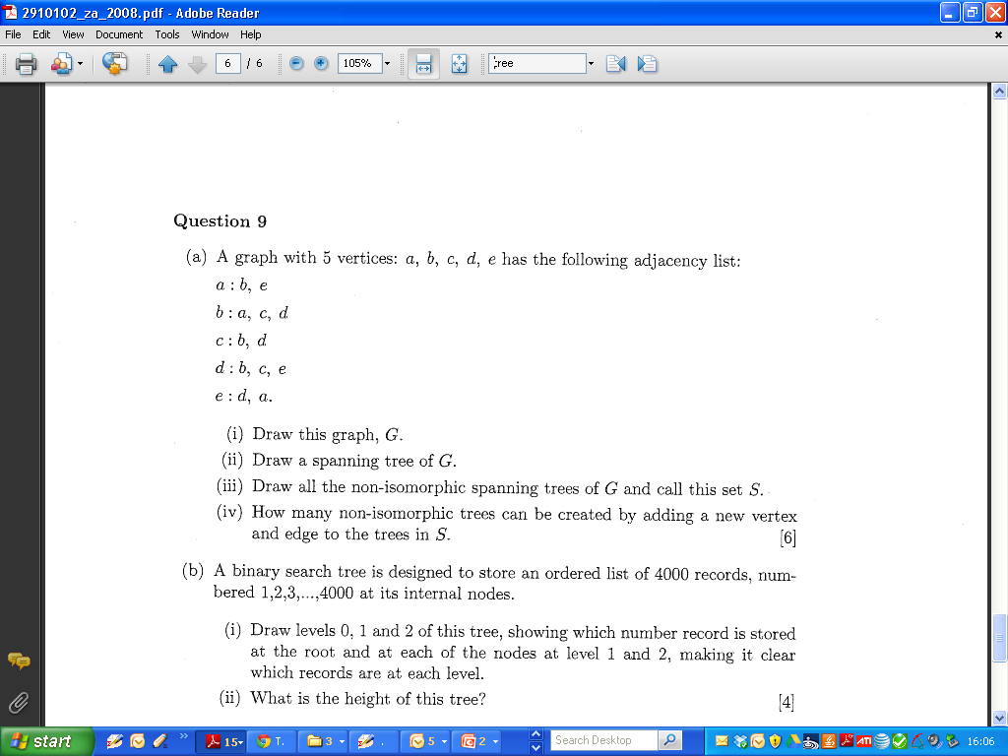
Trees : Properties of Trees 2008 Zone A Q9

Slide 7
Trees : Properties of Trees 2008 Zone A Q9

Slide 8
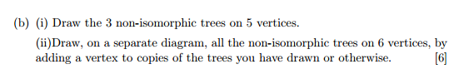
Trees : Properties of Trees 2008 Zone A Q9
Part IV
Examiner’s Commentaries : Then it is a question of adding another vertex and edge to each of these in all possible places and finally eliminating the isomorphic ones to do part (iv).
Simpler Exercise (2006 Q9)

Slide 9
Trees : Properties of Trees 2006 Zone A Q9

Slide 10
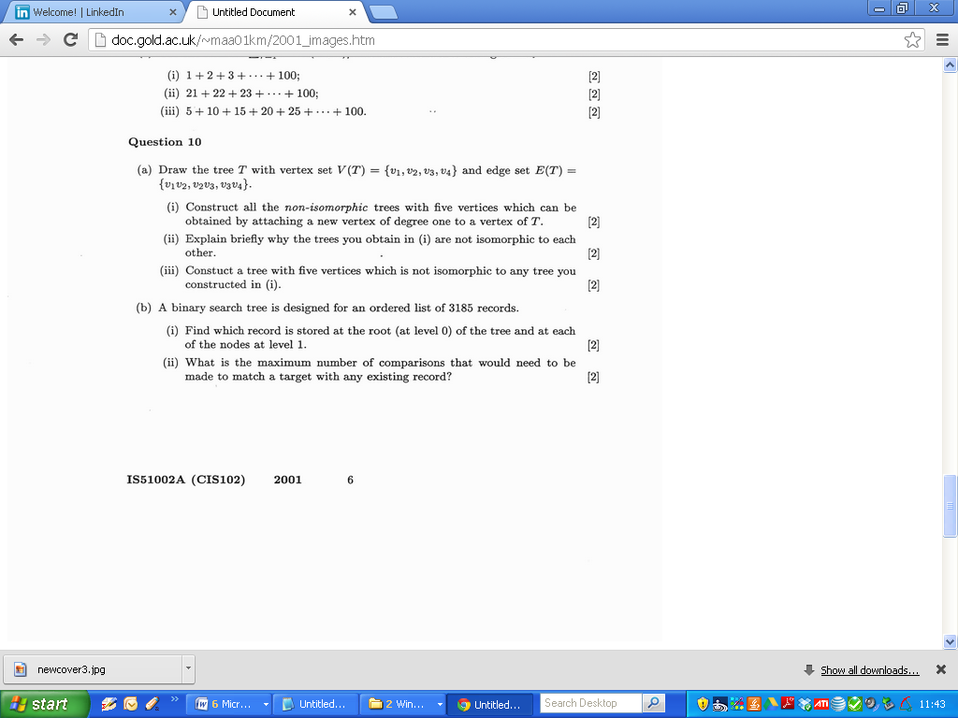
2001

Slide 11
2001

Slide 12
2001

Slide 13
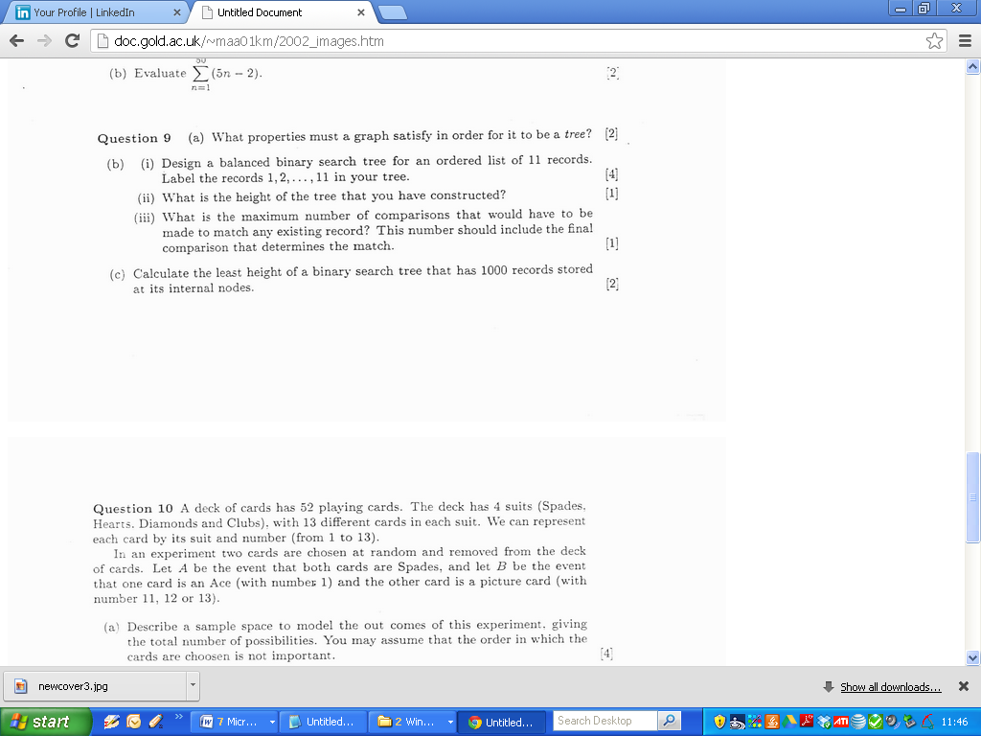
2002

Slide 14
2002

Slide 15
2002

Slide 16
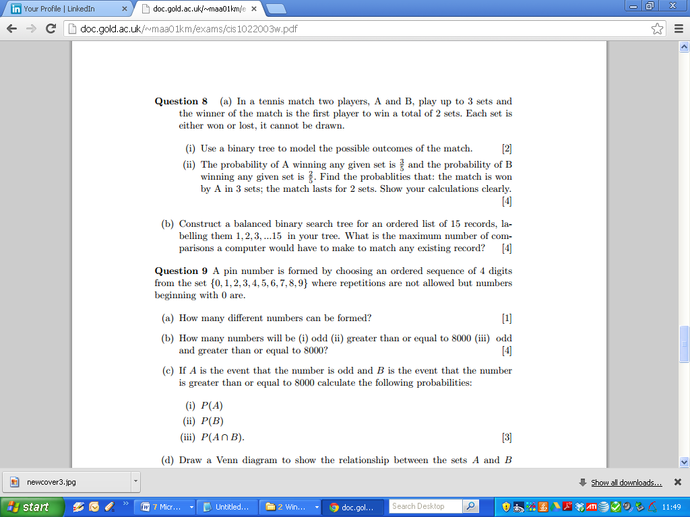
2003

Slide 17
2003

Slide 18
2003

Slide 19
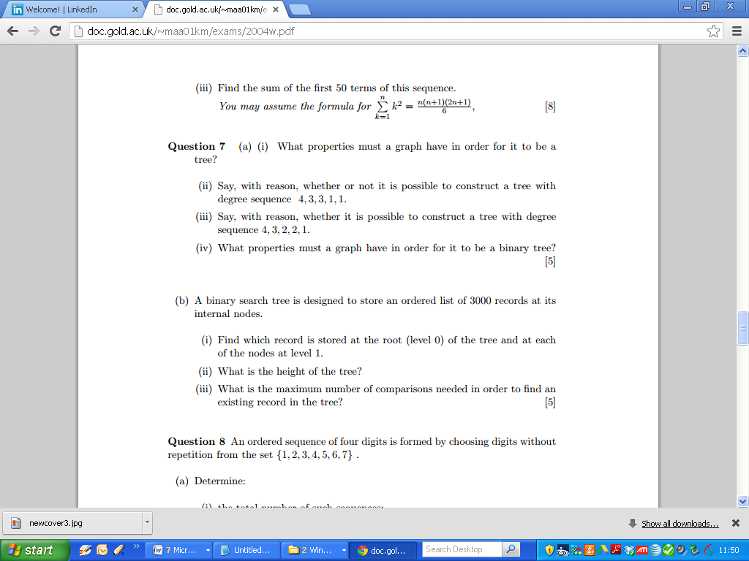
2004

Slide 20
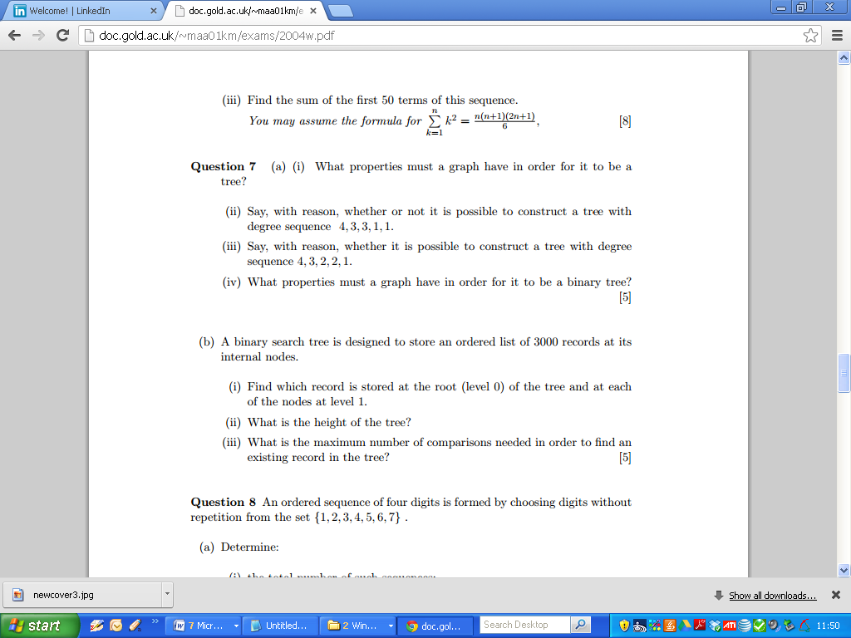
2004

Slide 21
2004

Slide 22
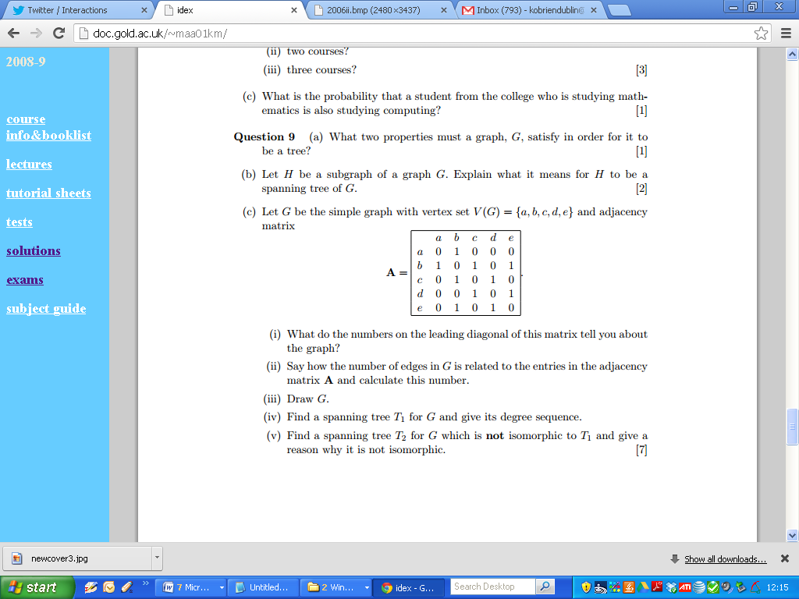
2005

Slide 23
2005

Slide 24
2005

Slide 25
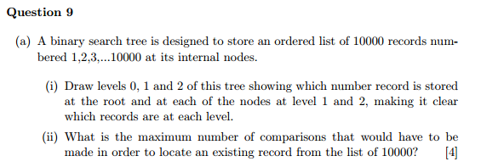
2006

Slide 26
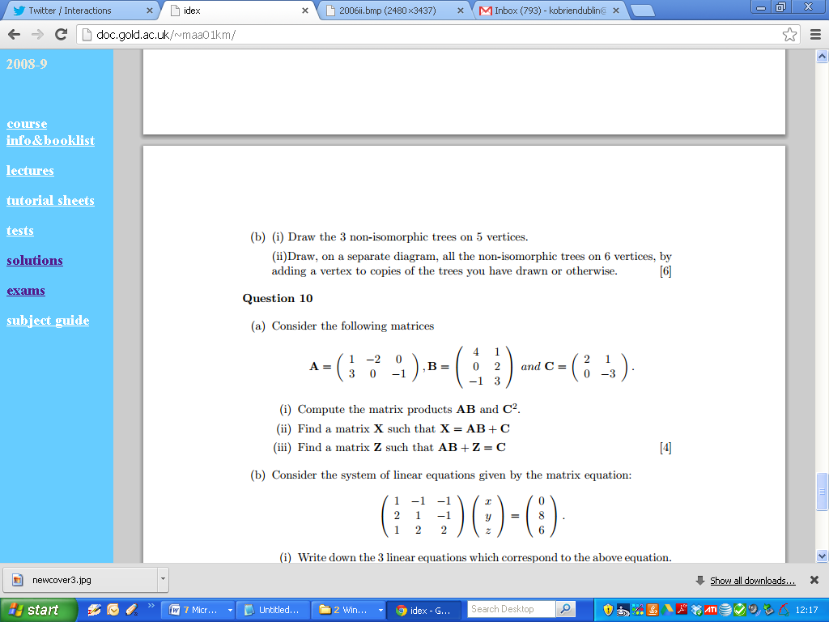
2006

Slide 27
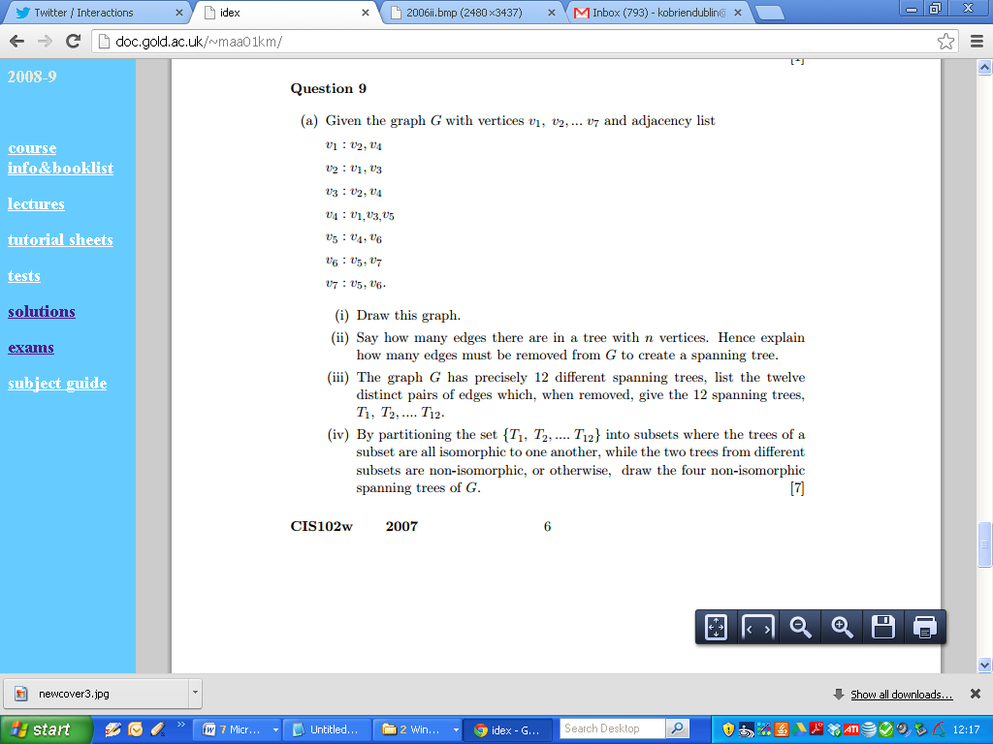
2007

Slide 28
2007

Slide 29
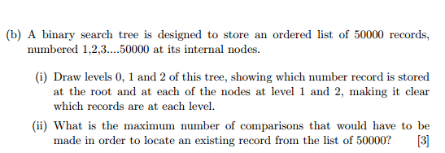
2007

Slide 30
2007

